Slide 1
APACHE PIG
Le Thi Minh Chau
Faculty Of Information Technology
HCMC University Of Technology And Education

Slide 2
Module Contents
Introduction to Pig
Hadoop Pig Architecture

Slide 3
Module Contents
Introduction to Pig
Hadoop Pig Architecture

Slide 4
What is Pig?
It is an open-source data flow language
Pig Latin is used to express the queries and data manipulation operations in simple scripts.
Pig converts the scripts into a sequence of underlying Map Reduce jobs.

Slide 5
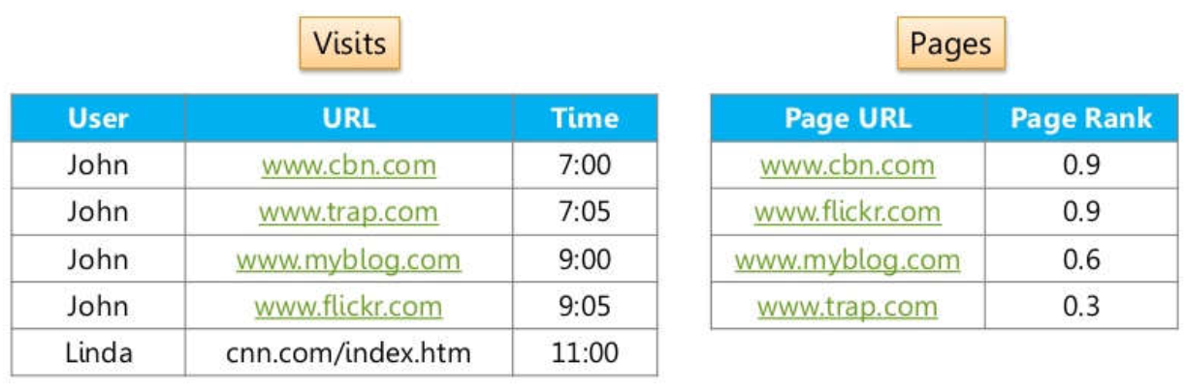
Internalize Pig

Slide 6
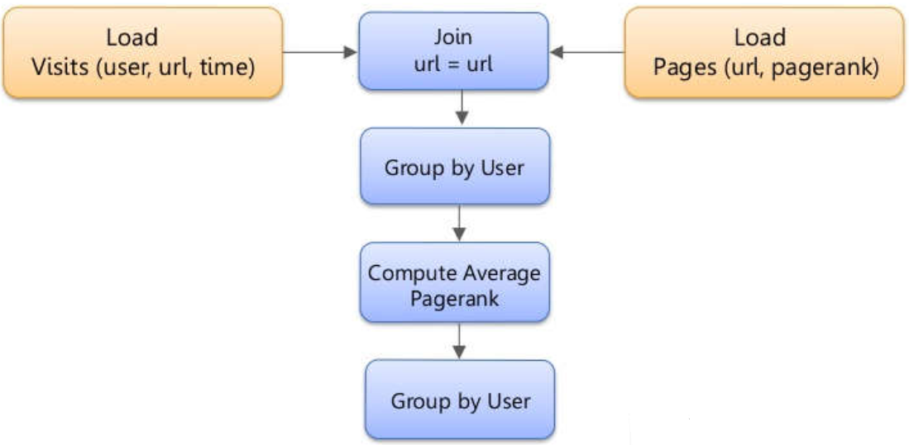
Internalizing Pig

Slide 7
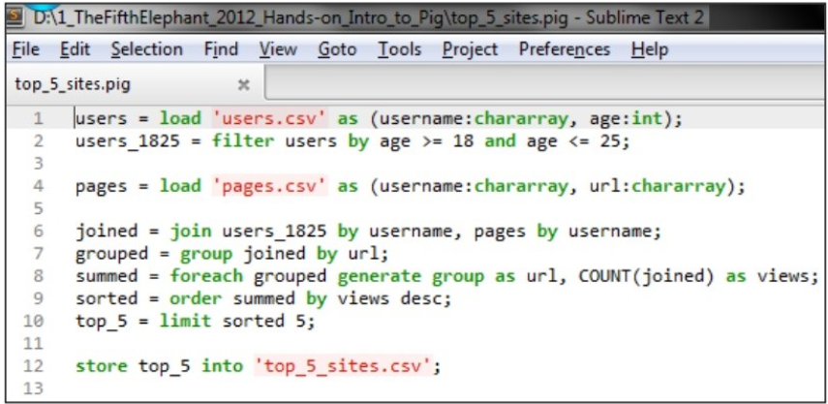
Why Pig?

Slide 8
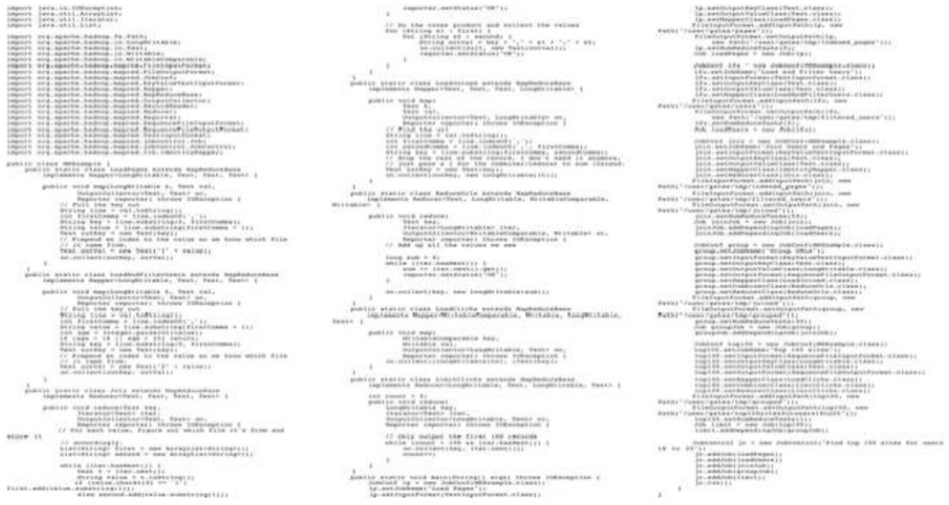
Equivalent Java MapReduce Code

Slide 9
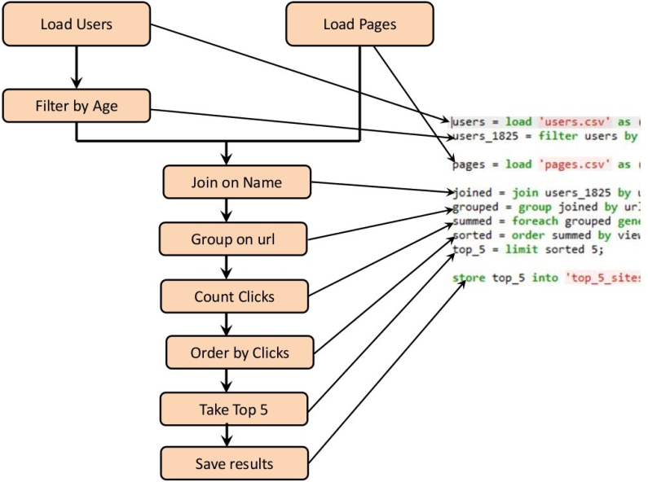
Internalizing Pig

Slide 10
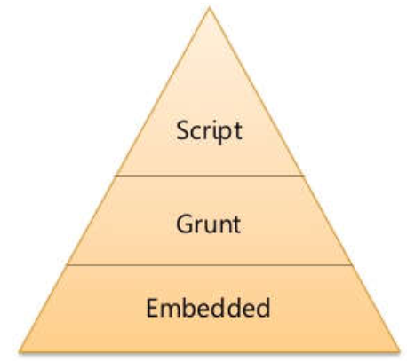
Ways to handle Pig
Grunt Mode
It’s interactive mode of Pig
Very useful for testing syntax checking and ad-hoc data exploration.
Script Mode
Runs set of instructions from a file
Similar to a SQL script file
Embedded Mode
Executes Pig programs from a Java program
Suitable for creating Pig Script on the fly.

Slide 11
Modes of Pig
Local
Need access to a single machine
All files are installed and run using your local host and file system
Is invoked by using the –x local flag.
pig –x local
Map Reduce
The default mode
Need access to a Hadoop cluster and HDFS installation
Can also be invoked by using the –x mapreduce flag or just pig
pig
pig –x mapreduce

Slide 12
Module Contents
Introduction to Pig
Hadoop Pig Architecture

Slide 13
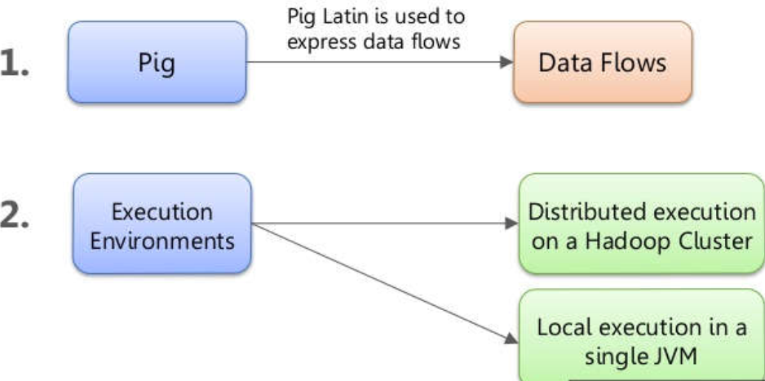
Pig Components

Slide 14

Pig Programs Execution
Pig is just a wrapper on top of MapReduce Layer
It parses, optimizes and converts the Pig script to a series of Map Reduce jobs

Slide 15

Q&A

